Slide 1
Java Workshop 7 – Inheritance and Encapsulation
This workshops encapsulates what inheritance in OOP is.
Ben Schwarz

Slide 2
Lesson Outline
Inheritance
Encapsulation

Slide 3
Remember the analogy on books?
Your creating a program that has to keep track of a book production facility
Each book only differs slightly from each other in characteristics.
A class is like a blueprint for the building of a book. It contains all the books characteristics.
An object is like a book made from the blueprint class.

Slide 4
What makes OOP so good?
But what is so good about OOP? Why don’t we just use “Do This/Do That” programming languages?
Continuing the book analogy, imagine the that you have already written a computer program that keeps track of book creation within the book factory. Then, the boss of the factory decides to modify the books so that they are produced with cover jackets as well as the actual book.
If I were to use a FORTRAN style of computer programming, my instructions would look a lot like this:
This is comparable to you creating a long list of instructions to tell the computer what to do, rather then a blueprint
Get paper from the pile
Print text on the page
Flip page then print text again
. . .
Analogy inspired by “Java for Dummies 6th Edition”

Slide 5

How can we modify our book blueprint?
To modify this plan, you have to not only sort through the whole list to find and edit the instructions to make the book cover, but the instructions could be on pages 461, 311-816, 14 and 8
To make matters worse, if someone else made the plan, you would have to interpret the complicated instructions of other people, making the task much harder
However, beginning with a class is like beginning with a blueprint. If we want to have a book with a jacket around the outside instead of a book with no jacket, we can start with a generic book blueprint that only has the basic characteristics of a book
Analogy inspired by “Java for Dummies 6th Edition”

Slide 6
New Books
From this generic blueprint, we can create two more blueprints, one for a book with a jacket, and one for a book without(named the bookWithJacket blueprint and bookNoJacket blueprint)
Our boss at the book factory is amazed that you were able to make these changes so quickly, but being the sceptical man that he is, he poses a question. “You called one of the blueprints the ‘bookWithJacket’ blueprint. How can you do this if it’s just a blueprint for a jacket and not for a whole book’”
You then knowingly answer “The ‘bookWithJacket’ blueprint can say on it, ‘For information about how to make the rest of the book, see the original book blueprint’.”
That way, the bookWithJacket class allows you to describe how to make a whole book, despite the fact that you only described how to make a jacket. The bookWithoutJacket class can do the same.
With this setup we can take advantage of all the work we already did to create the original book blueprint, saving lots of time and money
Analogy inspired by “Java for Dummies 6th Edition”

Slide 7
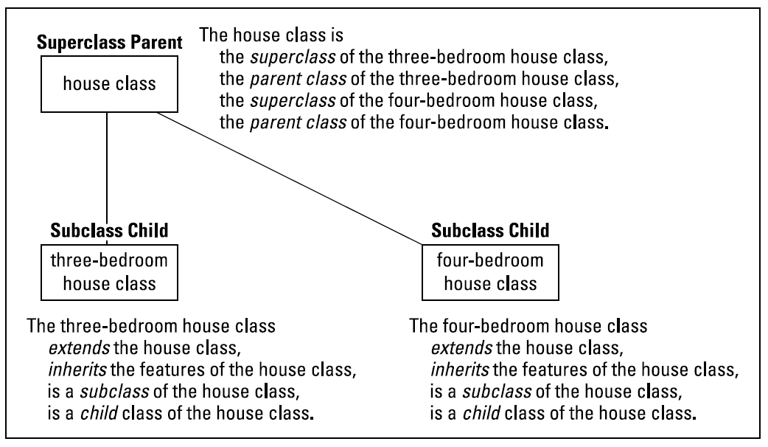
Inheritance
In object-oriented programming languages like Java, this is called inheriting the characteristics of the original book class. We also say that the bookWithJacket and bookWithoutJacket classes are extending the original book class, as they are inheriting its characteristics

Slide 8
Superclass
The original book class is known as the superclass of the Jacketed and Not-Jacketed book classes.
Similarly, the Jacketed and Not-Jacketed book classes are known as subclasses of the original book class
This can also be stated as parent and child classes.
Going back one last time to the book analogy, you tell the boss that you can reuse the same standard book blueprint again and again and again in the future. Say if someone wants pop-up parts in their book, you could make another subclass of the main book blueprint.
If a subclass wants to change a characteristic of a parent class, they can override elements of the main class, and change what they mean

Slide 9
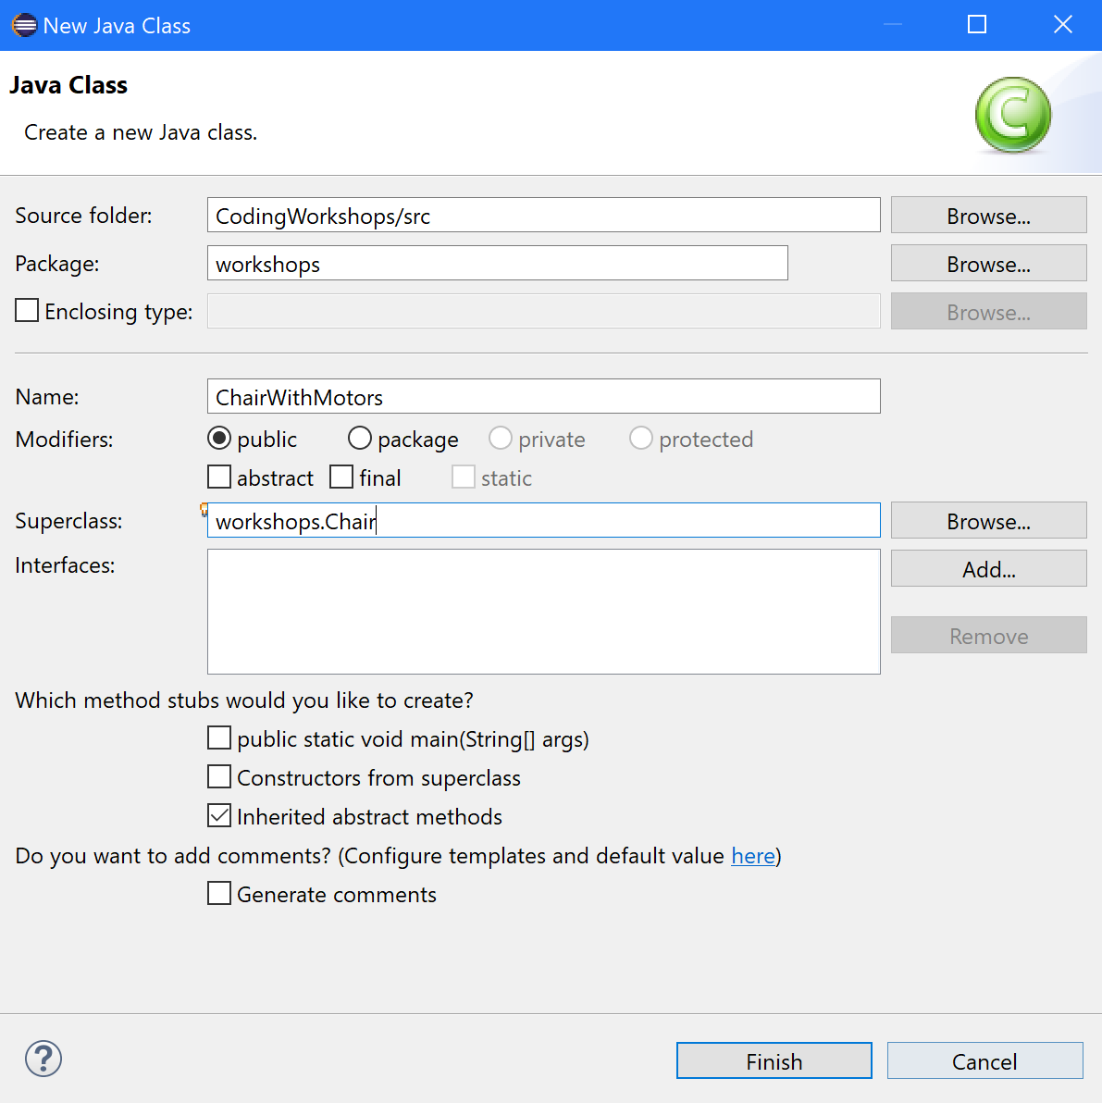
Inheriting from classes
But how do we inherit things from another class, like in the bookWithJacket and genericBook classes?
We are now going to create a subclass of the chair class
To begin with we are going to create a new class called ChairWithMotors

Slide 10
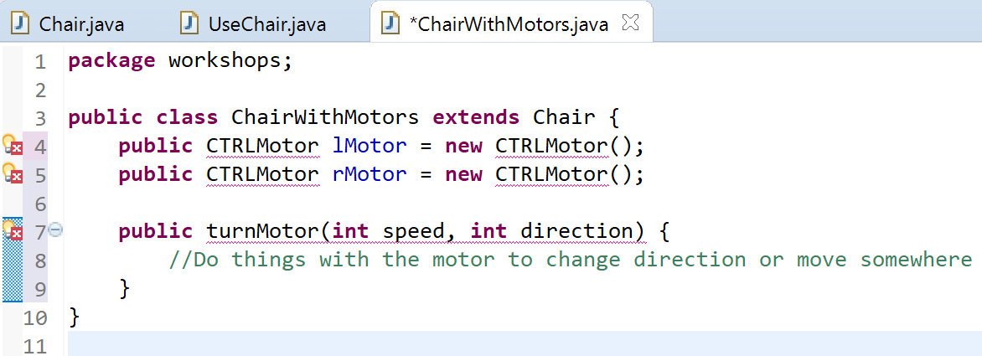
Creating Subclass
To create a subclass of another class, you use the keyword extends, and then the name of the class you want to make a subclass of
Saying it again, this means that the ChairWithMotors class now has the same fields and methods as the generic Chair class
You can then add extra fields, methods, and constructors, to the subclass
So ChairWithMotors is a chair, but with motors as well – in comparison to the generic chair class, which doesn’t have motors

Slide 11
Inheritance - Example
Say we want to represent cats and dogs, along with a number of other animals. Simplifying reality, all animals have the following info:
Actions: Move, make a noise, display
Additional data: Number of legs, warm/cold-blooded
We can use inheritance to avoid repeating this basic structure for every animal (among other things – inheritance is very useful).
Animal
Mammal
Cat
Dog

Slide 12
Inheriting Properties
Animal
Methods: Move, make noise, display
Attributes: Number of legs, is warm-blooded
Mammal [Sets is warm-blooded to true]
Methods: None
Attributes: Is a pet
Cat [makes “meow” noise, 4 legs, walks, pet]
Methods: Overrides display method
Attributes: Name
Dog [makes “bark”/“woof” noise, 4 legs, walks, pet]
Methods: Overrides display method
Attributes: Name
Animal
Mammal
Cat
Dog

Slide 13
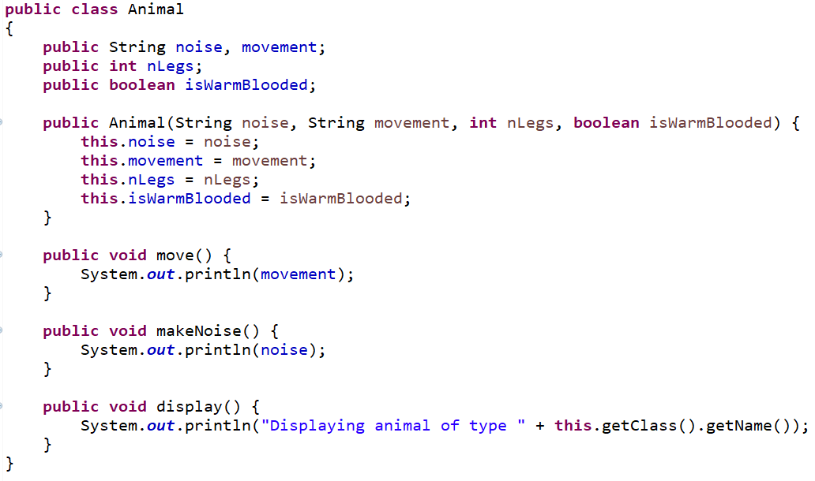
Animal Class
Overall superclass
Defines methods and attributes that exist for all subclasses
Defines constructor(s) that must be used by subclasses
Defines default behaviour where possible

Slide 14
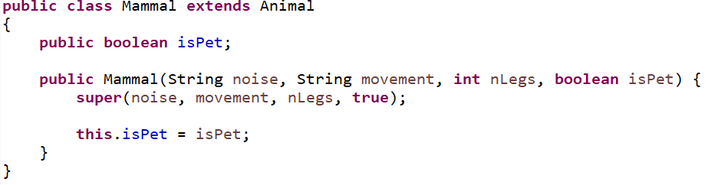
Mammal Class
Subclass of Animal, Superclass of Cat and Dog
Calls a superconstructor, potentially with fixed values
Can (but doesn’t) override existing methods
Performs same tasks as overall superclass for its own subclasses

Slide 15
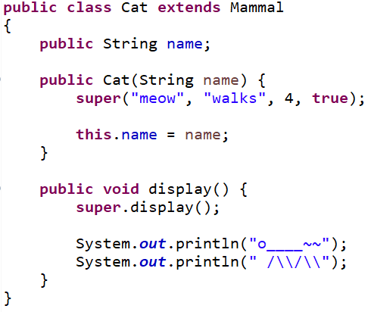
Cat Class
Subclass of Mammal
Calls superconstructor
Defines more methods and/or attributes
Overrides existing methods

Slide 16
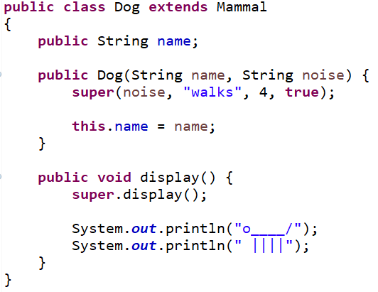
Dog Class
Subclass of Mammal
Calls superconstructor
Defines more methods and/or attributes
Overrides existing methods
This is different to Cat in that it’s still passing a parameter through to the superconstructor.

Slide 17
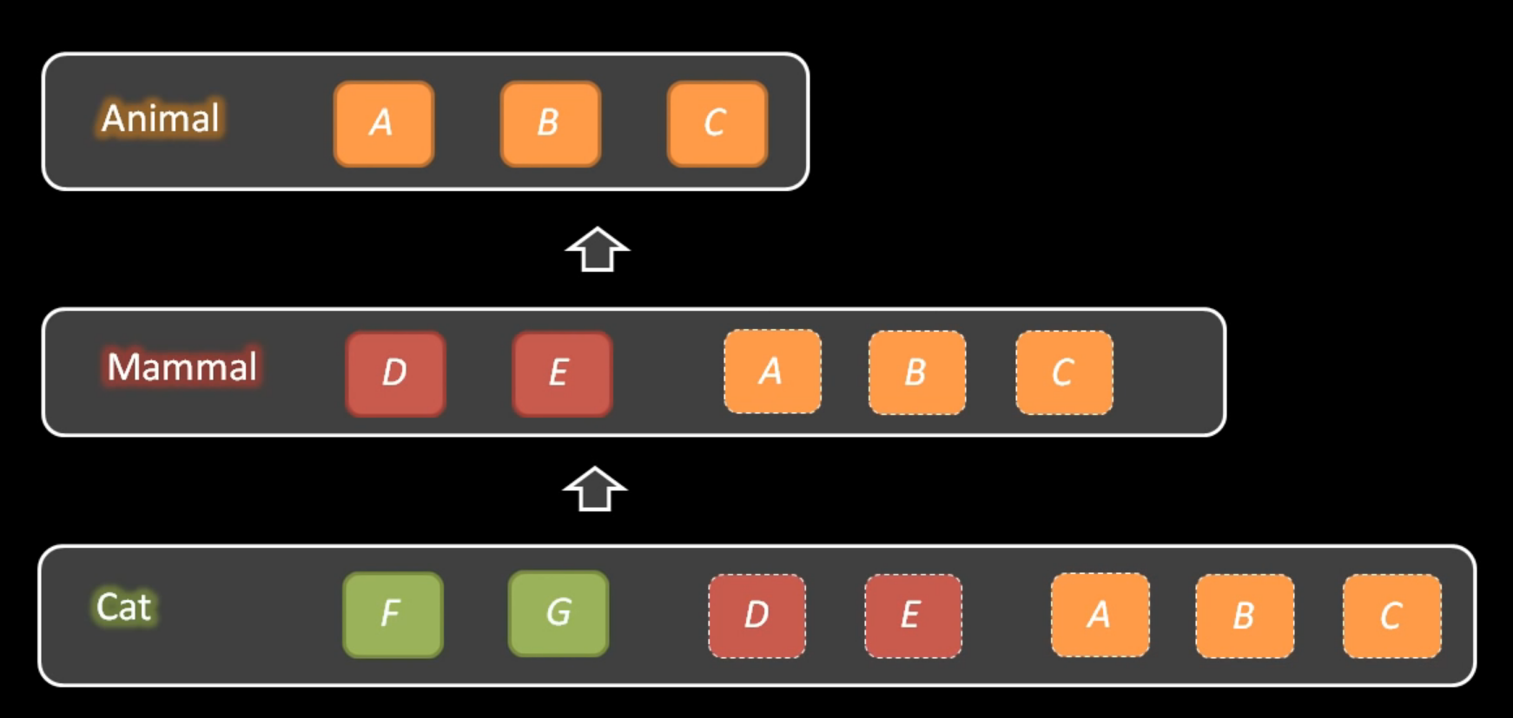
Inheritance of fields

Slide 18
When should I extend other classes?
Simple question is the relationship an is-a relationship or has-a relationship?
Proper relationship should be that the subtype is a type of a superclass.
Considered more specific form of a superclass. E.g. A cat is a type of animal.
Other case (has-a) is not an inheritance relationship but a compositional relationship.

Slide 19
Example
A car is composed of many parts e.g. steering wheel.
If we have a car class and a steering wheel class, it makes sense the car has a steering wheel field.
But it doesn’t make sense for the car to extend the steering wheel field as it isn’t one.
Instead the car would be extended to form like a Toyota, and the car itself may be extended from like a vehicle class.

Slide 20


Worked Example: Reptile and Snake
Requirements of Reptile:
Inherits existing Animal class
Overrides methods/passes fixed parameters for Animal class
Adds an attribute to determine whether the reptile is poisonous
Requirements of Snake:
Inherits Reptile class
Does same tasks as Cat and Dog
Animal
Reptile
Snake

Slide 21
Not allowed: Circular inheritance
Where a class indirectly inherits itself – BECAUSE IT MAKES NO SENSE
In Java, every class is required to inherit from another class with the superclass being called object
Also java doesn’t allow multiple inheritance
Soft Drink
Soda
Pop
Soda Pop

Slide 22
Your Turn
Create classes for Bird, Parrot and Hawk, in a similar way to Mammal, Cat and Dog.
Notes:
Parrots and Hawks do not make the same noise
Minimise copy-pasting – that tends to mean that you aren’t using your superclasses effectively
It should be possible to determine whether a Bird object is a bird of prey or not
Don’t waste time on ASCII art, but do override that method
Animal
Bird
Parrot
Hawk

Slide 23
Encapsulation

Slide 24
Visibility Modifiers
When we create classes, we can prevent free access to all of our variables and functions. The following modifiers limit their visibility:
We now have a large number of modifiers to keep track of, along with rules on placement and exclusivity.
Visibility modifier first
Data type last
[default], [abstract] and [static/final] are exclusive – you can only use one set
Modifier | Class | Package | Subclasses | Anywhere
public | ✓ | ✓ | ✓ | ✓
protected | ✓ | ✓ | ✓
No modifier | ✓ | ✓
private | ✓

Slide 25
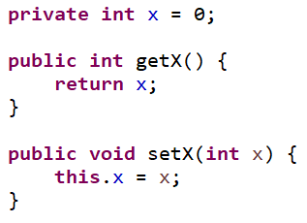
Encapsulation
Encapsulation is a concept in OOP design where data and the methods that directly use or modify that data are grouped into a single unit – a class.
In many ways we’ve already looked at the benefits of this kind of design when we first looked at OO. However, visibility modifiers allow us to enforce limitations on how our data is accessed.
The code below limits access to x to 2 public methods:

Slide 26
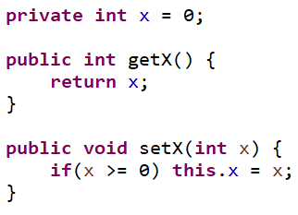
Why is Encapsulation Important?
By limiting access to variables just to methods we’ve written, we can:
Make attributes read or write only (or neither)
Prevent invalid data from being stored
Perform extra processing on requests to read/write data
Example:
Ensure that x is always non-negative

Slide 27
Implementation – Visibility
First, we need to determine the visibility of each of our attributes.
Most resources will say make all attributes private – in Java we have a few options:
Public: Constants you want to make available, and methods which are used to access your data
Protected: Anything you want subclasses to be able to directly access
No modifier: Uncommon, use if you really need direct access via your program but not others
Private: Everything else
Modifier | Class | Package | Subclasses | Anywhere
public | ✓ | ✓ | ✓ | ✓
protected | ✓ | ✓ | ✓
No modifier | ✓ | ✓
private | ✓

Slide 28
Implementation – Getters and Setters
We then need to make ‘getters’ and ‘setters’ for variables that we want to access or change the value of.
Getters return a value for the requested information, that may or may not just be a private attribute.
Setters change the data inside the class.
Conventionally, we use getData() and setData(value) for simple, single variable getters and setters.

Slide 29
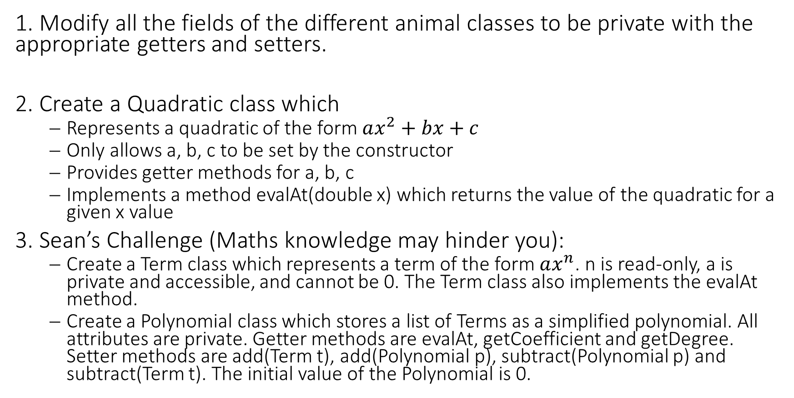
Your Turn
1. Modify all the fields of the different animal classes to be private with the appropriate getters and setters.
2. Create a Quadratic class which
Represents a quadratic of the form $ax^{2}+bx+c$
Only allows a, b, c to be set by the constructor
Provides getter methods for a, b, c
Implements a method evalAt(double x) which returns the value of the quadratic for a given x value
3. Sean’s Challenge (Maths knowledge may hinder you):
Create a Term class which represents a term of the form $ax^{n}$. n is read-only, a is private and accessible, and cannot be 0. The Term class also implements the evalAt method.
Create a Polynomial class which stores a list of Terms as a simplified polynomial. All attributes are private. Getter methods are evalAt, getCoefficient and getDegree. Setter methods are add(Term t), add(Polynomial p), subtract(Polynomial p) and subtract(Term t). The initial value of the Polynomial is 0.

Slide 30



Summary
You should now be able to:
Identify where variables are visible based on their modifiers
Describe the purposes of encapsulation
Use encapsulation principles to limit accessibility to data so that you can control the ability to change the values of an object

